Slide 1

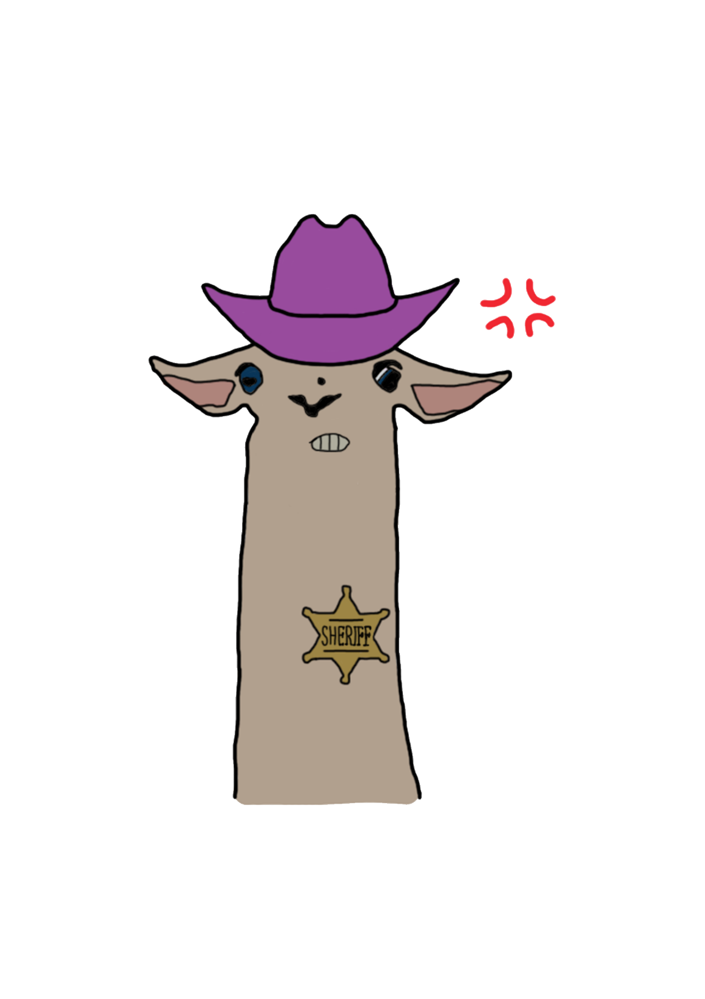

Group 6
Pitch Gold
Notes:
Everyone

Slide 2
The Brief
2D
Tap input
Turn-based single-device multiplayer
Symmetric level design
Easy to learn game yet hard to master
Notes:
Tom
Input is single instant of contact.
Local multiplayer – adversarial. Asynchronous player turns.
Symmetric – players have access to the same knowledge and equal opportunity regarding input effect.

Slide 3
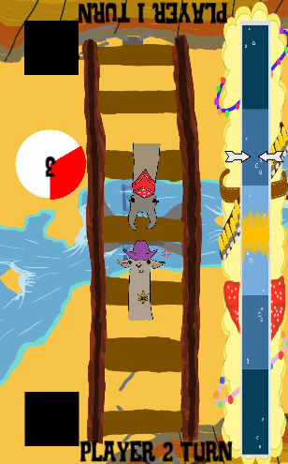
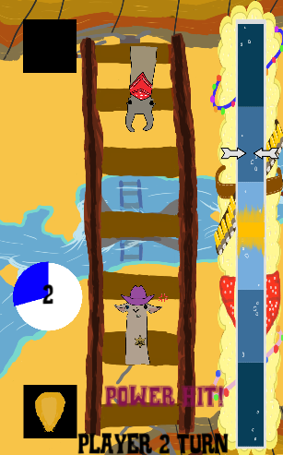
What is our Game?
Timed tap
Asynchronous, turn based
Win/lose condition
Notes:
Tom

Slide 4
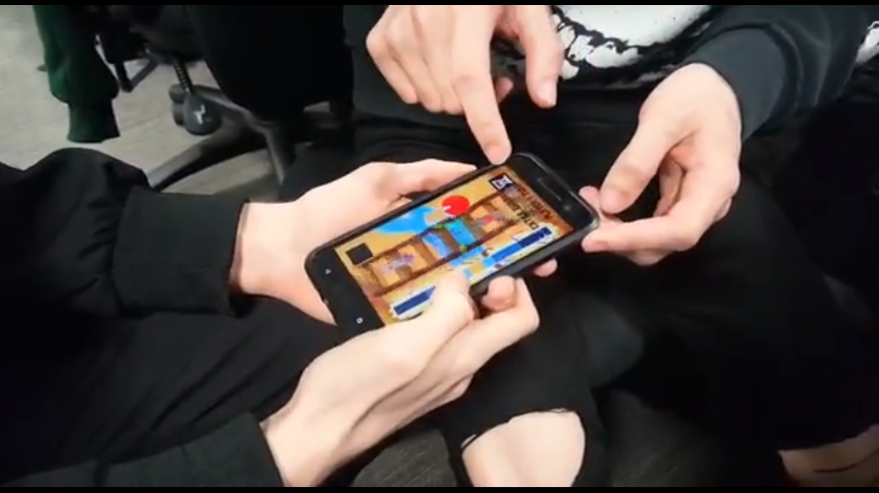
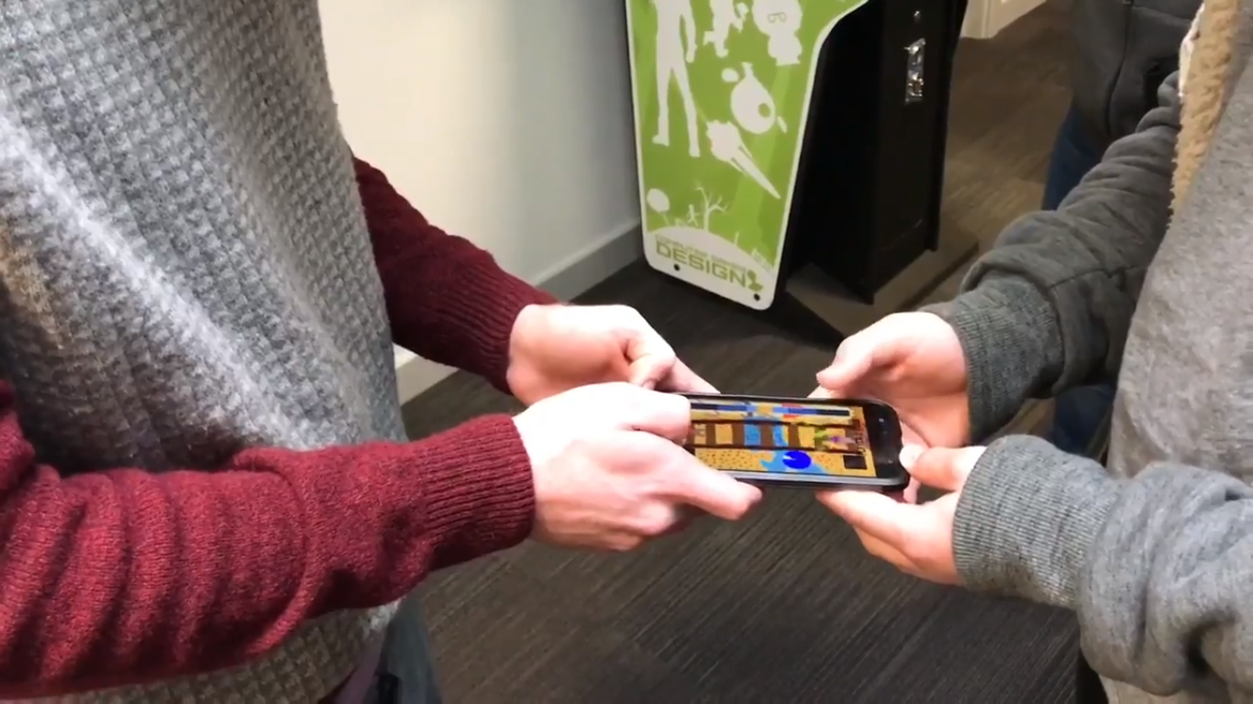
What does the player do?
Notes:
Tom

Slide 5
Game loop
Time
Progress
Tap
Notes:
Tom

Slide 6
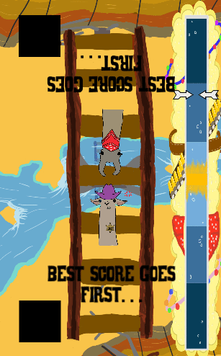
Final Build
Most accurate tap wins first turn
Notes:
Tom

Slide 7
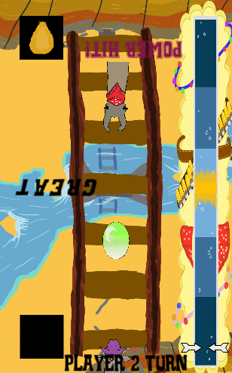
Final Build
Win condition
Notes:
Tom

Slide 8
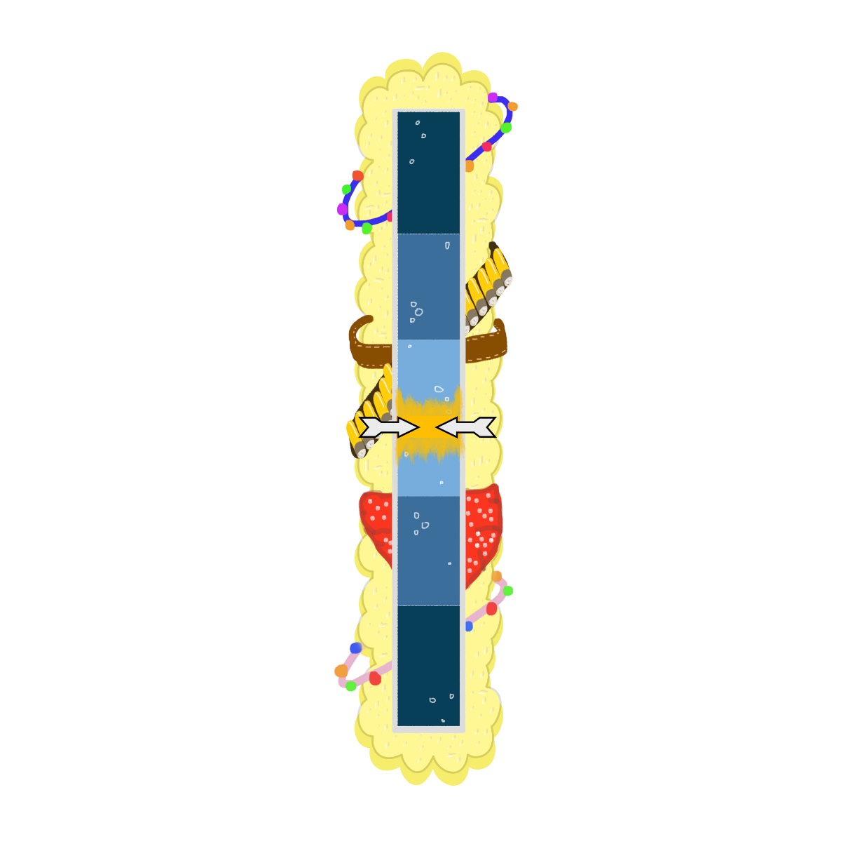

Power Meter
Speed
Zones
Feedback
Notes:
Dan

Slide 9

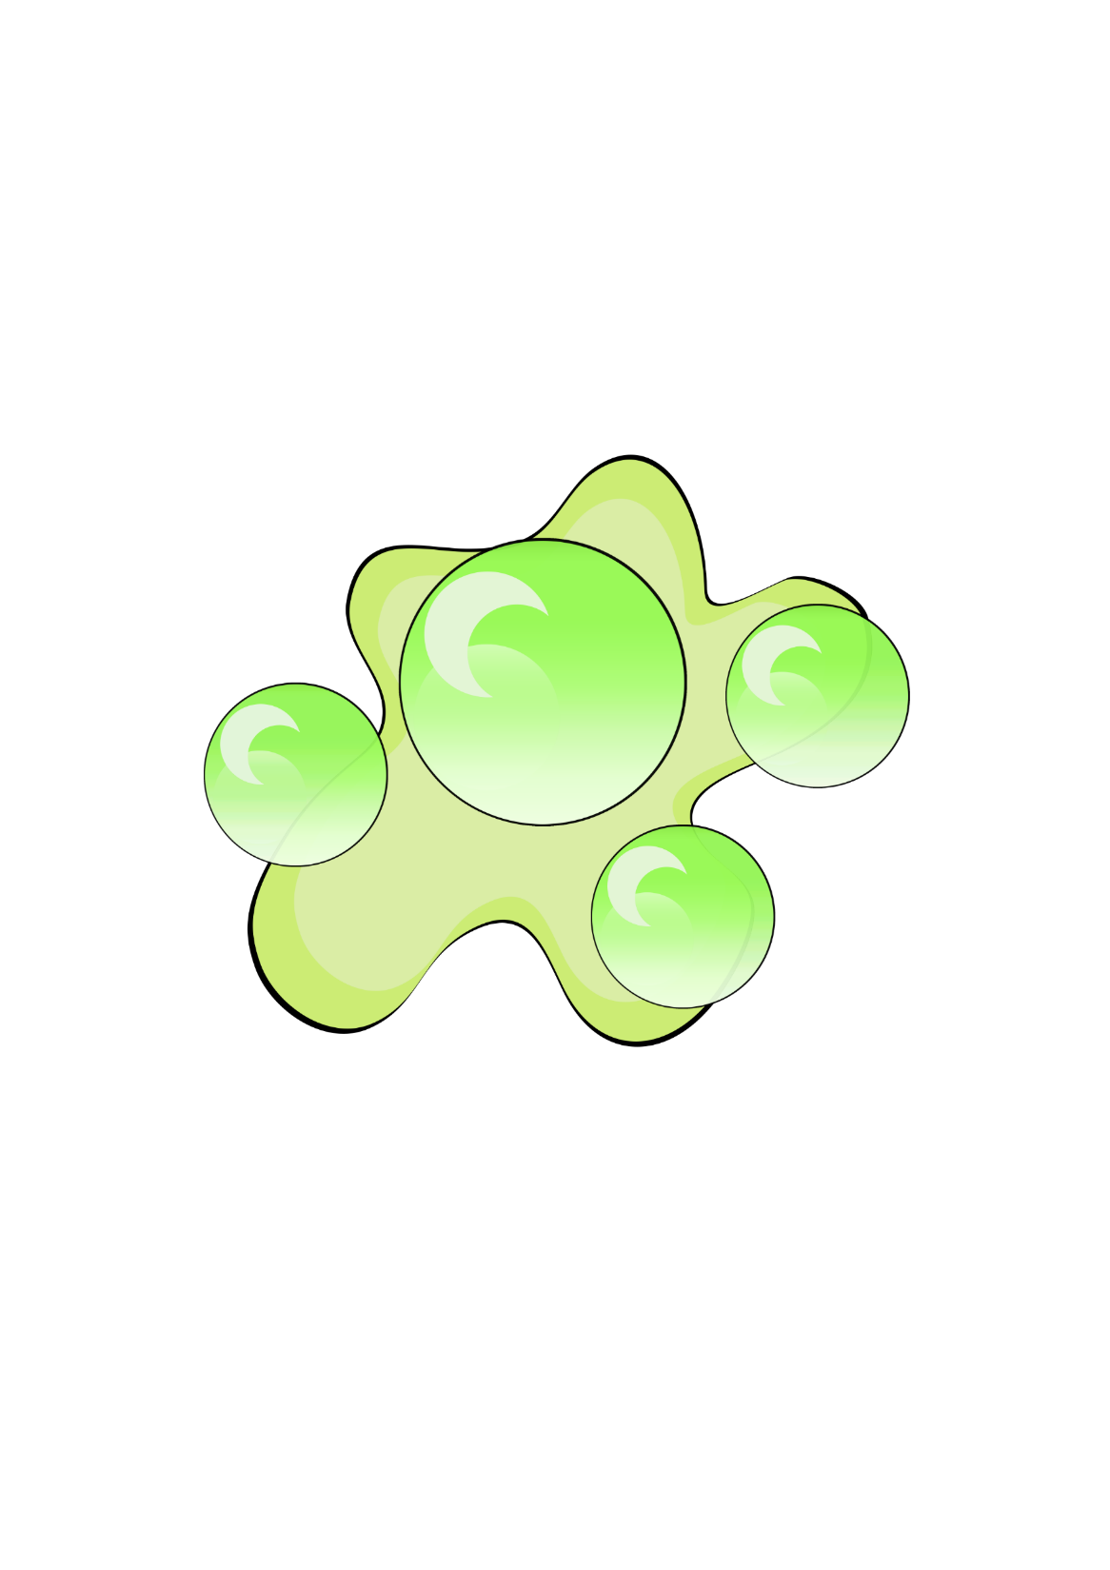

Character Design
Hv g g
Notes:
Jack

Slide 10
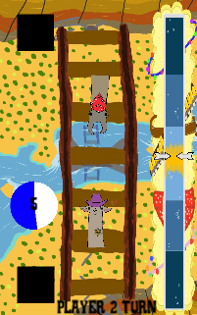
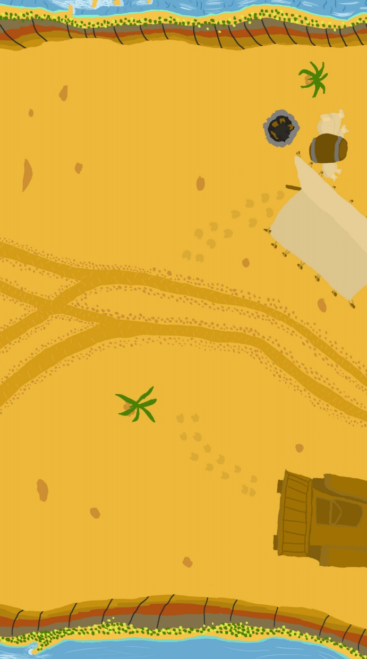
Background Design
Iteration: less ‘busy’ background
Visible hazards in game scene
Notes:
Jack

Slide 11

Playtest Response
Speed values adjusted, players felt ___________
Players expressed ________ at recover power up occurring too frequently
Player ___ background/power bar
Players at characters?
Players said hitting opponent didn’t feel good – added screen shake
Players stealing their turn, felt cheated, limited input to half screen
https://youtu.be/QnHehQsqNtM

Slide 12
Design Lessons
Initial design phase
Thinking of emotion first

Slide 13
Programming Lessons
Intuitive variable names
Making appropriate variables accessible in editor
Clear code layout with comments

Slide 14

Management Lessons
Communication
Scope

Slide 15

Notes:
all

